Slide 1
Riesz Pyramids for Fast Phase-Based Video Magnification
Neal Wadhwa¹ Michael Rubinstein^{2,1} Fredo Durand¹ William T. Freeman¹
¹MIT Computer Science and Artificial Intelligence Lab (CSAIL)
²Microsoft Research
Notes:
Hi, My name is Neal Wadhwa and I am going to talk about a new image representation, the Riesz pyramid, that allows for clean, real-time phase-based motion magnification.
Since this is the last session, I only talk for about half the time before moving onto a live demonstration of our new motion magnification technique.

Slide 2
Imperceptible Motions
Notes:
Specifically, we are interested in amplifying small motions that are all around us, but invisible to the naked human eye.
For example, these videos have lots of tiny invisible motions, but are apparently static.

Slide 3
Magnified Imperceptible Motion
Notes:
We seek to visualize the small motions by amplifying them.
Now, you can see the baby breathing, the crane swaying and one of the metal column’s modal shapes.

Slide 4
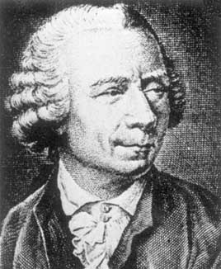
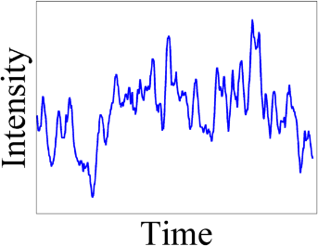
Eulerian Video Magnification
Examine the varying values at a fixed voxel grid (video)
[Wu et al. 2012]
Non Eulerian:
[Liu et al. 2005]
[Wadhwa et al. 2013]
[Rubinstein 2014]
Notes:
We don’t perform explicit motion estimation, which is costly and difficult to do well. Instead, to borrow a term from fluid mechanics, we focus on “Eulerian” techniques to amplifying motions,
* which basically means that instead of tracking pixels and shifting them explicitly - we only process and manipulate the changes at each pixel in the video independently, over time.

Slide 5
Previous Eulerian Methods
[Wu et al. 2012], [Wadhwa et al. 2013], [Rubinstein 2014]
Noise Amplification
Intensity
Clipping
Original
Wu et al. 2012 ($\sim$57 FPS)
Linear
Wadhwa et al. 2013 ($\sim$6.5 FPS)
Phase-Based
Notes:
Our group has recently introduced two Eulerian methods to amplify these small motions.
One works by linearly amplifying intensity variations. This method, shown in the middle, is very fast and capable of running in real-time, but suffers from noise amplification* and clipping artifacts*.
Last year, we introduced phase-based motion processing, shown on the right, to alleviate these artifacts. It produces a much cleaner video, but takes almost 8 times longer making it difficult to implement in real-time.

Slide 6
Riesz Pyramids
New method is much faster, but similar quality
Original
Wu et al. 2012 ($\sim$57 FPS)
Linear
Wadhwa et al. 2013 ($\sim$6.5 FPS)
Phase-Based
This talk ($\sim$32 FPS)
Riesz Pyramid
Notes:
We introduce a new method in this talk, now shown on the right that is both fast and clean. It has quality comparable to the phase-based method, but speed similar to the linear method.
In fact, we were able to produce a real-time implementation capable of processing 32 Frames Per Second on a laptop, which we will demonstrate later in this talk

Slide 7
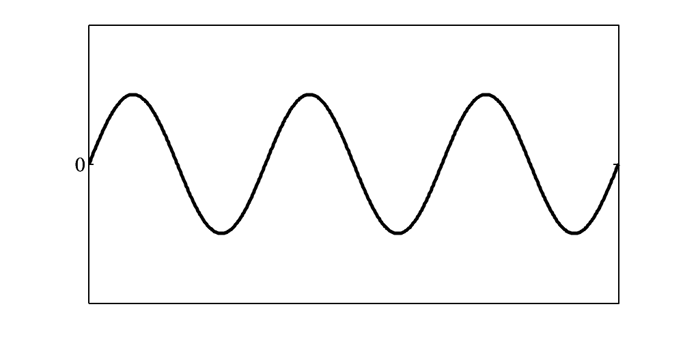
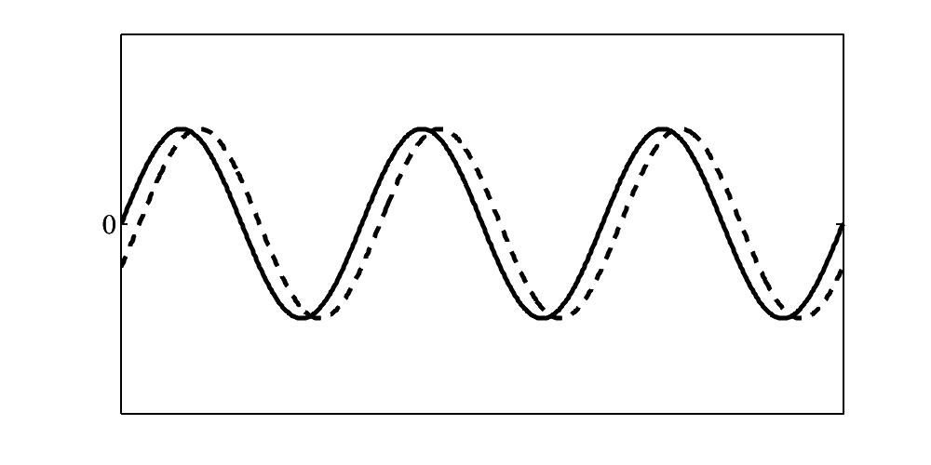
Amplifying Intensity Variations
Amplify Intensities [Wu et al. 2012]
Overshoot
Frame at time t
Intensity
Frame at time t+dt
Amplifying Intensities
Space ($x$)
Undershoot
Notes:
The benefits of amplifying phase variations over intensity variations are made clear by the example of sinusoids.
Here’s a sinusoid, and
*here’s a slightly shifted copy of it, in which it moved a little bit. We would like to magnify the motions to make them easier to see.
If we amplify the intensity difference between them, shown in red, as is done in the linear method by WU et al. 2012, we can increase the sinusoid’s motion
* But as the amplification increases, the sinusoid’s amplitude gets increased resulting in overshoot and undershoot.

Slide 8
Amplifying Phases
But phase is only defined in one dimension
Frame at time t
Frame at time t+dt
Intensity
Amplifying Intensities
Amplifying Phases
Space ($x$)
Notes:
Phase shifting the sinusoids, shown in green, will result in exact translations. For general images, we can break an image into subbands that resemble sinusoids.
However, phase is only defined for one dimensional signals.

Slide 9
Complex Steerable Pyramid
Previously used 8 orientation complex steerable pyramid
CSP Limitations | Eight Orientation CSP
Overcompleteness | 21x
Implementation | Frequency Domain
Notes:
We previously solved this problem by using the complex steerable pyramid, which breaks the image into subbands corresponding to different scales and orientations.
That is, it uses a fixed set of orientations, denoted by the red arrows, that are essentially 1D.
However, this representation is 21x overcomplete and *
Has a costly frequency domain implementation

Slide 10
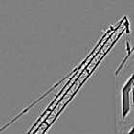
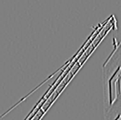
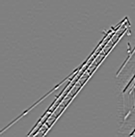
Riesz Pyramid
Two dimensional phase in non-oriented subbands
Laplacian
Pyramid
x-derivative
Laplacian Pyr.
y-derivative
Laplacian Pyr.
 | Eight Orientation CSP | Riesz Pyramid
Overcompleteness | 21x | 4x
Implementation | Frequency Domain | Compact Linear Filters
Notes:
To maintain the advantages of phase-based processing with the added benefit of speed, we introduce the Riesz Pyramid which allows for phase-based processing without oriented subbands.
The Riesz pyramid can be computed in the primal domain quickly by first computing a Laplacian pyramid and then computing its vertical and horizontal derivatives.
It is only 4 times overcomplete
and it is implemented with compact primal domain filters!

Slide 11
Riesz Pyramid
Time to build and collapse a 960x540 image
 | Two Orientation CSP | Riesz Pyramid
Overcompleteness | 5.3x | 4x
Implementation | Frequency Domain | Compact Linear Filters
Running Time | 126ms | 37ms
 | Eight Orientation CSP | Riesz Pyramid
Overcompleteness | 21x | 4x
Implementation | Frequency Domain | Compact Linear Filters
Running Time | 500ms | 37ms
Notes:
*As for actual running times, the Riesz pyramid can build and collapse a 960x540 pixel image 13 times faster than the eight orientation CSP.
*Even if we compare to the smallest, two orientation complex steerable pyramid, shown in the borrom table, the Riesz pyramid is still 3 times faster and less overcomplete!

Slide 12
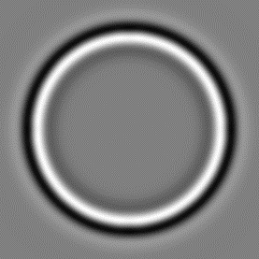
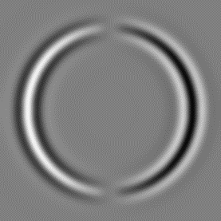
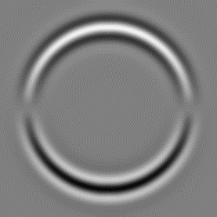
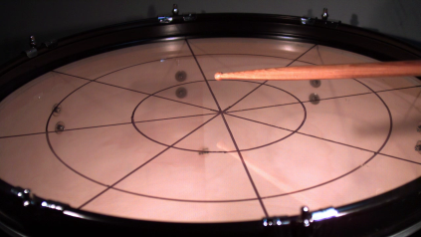
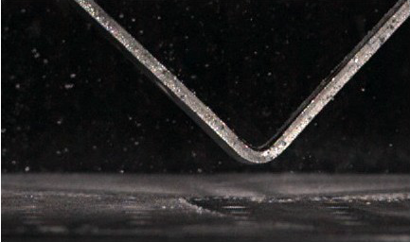
Talk Overview
Review of Phase-Based Video Magnification
Our SIGGRAPH 2013 Paper (Wadhwa et al. 2013)
Riesz Transform and Riesz Pyramid
This paper
Results and Live Demonstration
Notes:
In the remainder of the talk, I will briefly review phase-based motion processing in more detail
And then talk about Riesz pyramids and the Riesz transform
Before finally showing some new cool results and a live demonstration made possible by the Riesz pyramid

Slide 13
Talk Overview
Review of Phase-Based Video Magnification
Our SIGGRAPH 2013 Paper (Wadhwa et al. 2013)
Riesz Transform and Riesz Pyramid
This paper
Results and Live Demonstration

Slide 14
Fourier Shift Theorem
$$f\left(x\right)$$
Space ($y$)
Intensity
FFT
Space ($x$)
Space ($x$)
$$\sum_{ω=−∞}^{∞}{A_{ω}e^{iω}}$$
FFT
$A_{1}×$
$${+A}_{2}×$$
$+…$
Intensity
Intensity
Space ($x$)
Space ($x$)
Phase ($e^{−iδ}$)
Phase($e^{−i2δ}$)
Notes:
Phase-based motion processing relies on a local version of the Fourier Shift Theorem
Consider this image profile.
We can use the Fourier transform to break the signal into sinusoids, only two of which are shown here.
The Fourier shift theorem states that we can shift the signal by modifying the phase of the sinusoids.

Slide 15
Phase Shifting Complex Sinusoid
Intensity
Space (x)
$$cos⁡(ωx)$$
$$sin⁡(ωx)$$
$$\cos\left(ωx−φ\right)$$
$$=\cos\left(ωx\right)\cos\left(φ\right)−\sin\left(ωx\right)\sin\left(φ\right)$$
Notes:
For a complex sinusoid, phase shifting is easy.
We just take the real part, cosine and the imaginary part, sine and use the double angle formula to shift by an arbitrary phase

Slide 16
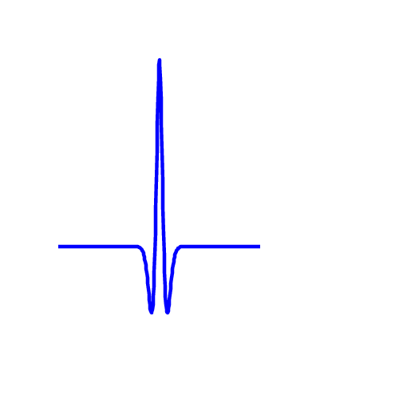
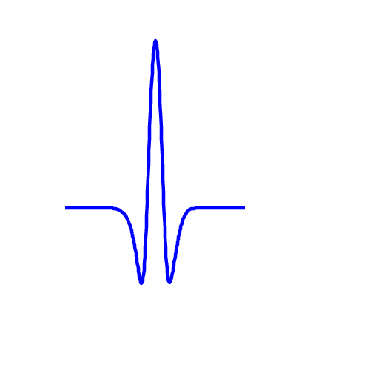
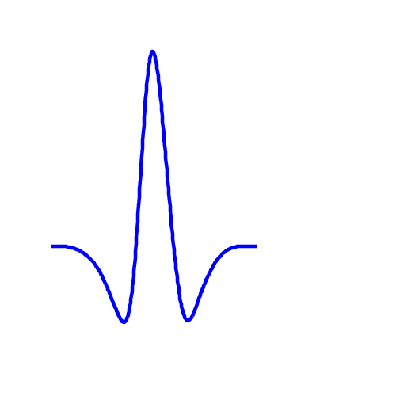
Subbands
Intensity
Intensity
Space ($x$)
Intensity
Intensity
Laplacian Pyramid
Filter Bank
Space ($x$)
Notes:
However, this processing can only handle global motions.
To handle local motions, we decompose an image profile into sub-bands, which are local in both space and frequency.
These subbands are real signals analagous to the cosine in a complex sinusoid. The imaginary sine part is missing

Slide 17
Hilbert Transform
Real
Intensity
Space (x)
Imaginary
$$\cos\left(ωx\right)={\frac{1}{2}e}^{iωx}+{\frac{1}{2}e}^{−iωx}$$
Frequency ($ω$)
$$\sin\left(ωx\right)={\frac{i}{2}e}^{iωx}−{\frac{i}{2}e}^{−iωx}$$
Notes:
Going back to sinusoids, the relationship between cosine and sine is a 90 degree phase shift.
In the Fourier domain, both sine and cosine consist of two delta functions at omega and –omega,
Relative to cosine, the positive frequency in sine is shifted 90 degrees forward while the negative frequency is shifted 90 degrees backwards.

Slide 18
Hilbert Transform
Transfer function in 1D
$$T\left(ω\right)=\left\{\begin{aligned}e^{i\frac{π}{2}}, ω<0 \\ &e^{−i\frac{π}{2}}, ω>0\end{aligned}\right.$$
$$\frac{π}{2}$$
Phase Response
$$−\frac{π}{2}$$
Frequency (Hz)
Notes:
The Hilbert transform specifies this relationship between cosine and sine for general signals.
Positive frequencies are shifted 90 degrees forward and negative frequencies are shifted 90 degrees backwards.
So that every cosine in a signal is mapped to sine and vice versa

Slide 19
Hilbert Transform of Subband
Only Phase Shift Local Region
Local Phase shift $↔$Local Translation
Intensity
Space (x)
Original
Subband
Hilbert
Transform
Locally Phase
Shifted Subband
Quadrature Pair
Notes:
Then, we can take the real subband and using the Hilbert Transform, compute a 90 degrees phase shifted imaginary part forming a quadrature pair
At each pixel, we’ll have a pair of numbers, one real and one imaginary that together form a complex number, that we can phase shift locally.
In this case, we use local phase changes to approximate local translations on the right side of the image profile.

Slide 20
Talk Overview
Review of Phase-Based Video Magnification
Our SIGGRAPH 2013 Paper (Wadhwa et al. 2013)
Riesz Transform and Riesz Pyramid
This paper
Results and Live Demonstration
Notes:
So far, we have covered the relationship between phase in subbands and local motions in one dimension.
We now turn to two dimensions and the Riesz Transform.

Slide 21
Hilbert Transform in 2D
Phase shift one half plane by ${90}^{∘}$, other half plane by $−{90}^{∘}$
Hilbert transform is not direction invariant
$${90}^{∘}$$
Frequency ($ω_{y}$)
$$−{90}^{∘}$$
Frequency ($ω_{x}$)
Frequency ($ω_{x}$)
Frequency ($ω_{x}$)
Notes:
Specifically, there is a problem in applying the Hilbert transform in two dimensions.
The Hilbert transform would phase shift one half plane by 90 degrees and the other half plane by –90 degrees, but there are many choices of half plane
And all choices involve choosing a preferred direction, which is something that images and motions typically do not possess.

Slide 22
Complex Steerable Pyramid Solution
Frequency ($ω_{y})$
$$×$$
$$=$$
Scale
Frequency ($ω_{y})$
Frequency ($ω_{y})$
$$×$$
$$=$$
Orientation
Frequency ($ω_{x})$
Frequency ($ω_{x})$
Frequency ($ω_{x})$
Frequency ($ω_{x})$
Idealized Complex Transfer Function
Real Part
Hilbert Transform
Imag. Part
Notes:
The complex steerable pyramid deals with this by breaking the image in to both scales *
and at least two orientations.
Then, we can take the real part of the pyramid *
and apply the Hilbert transform in the direction of the subbands orientation*
To get the imaginary part of the pyramid
The real and imaginary parts form a complex subband that can be phase shifted as before

Slide 23
Limitations of Complex Steerable Pyramid Implementation
9x9 Oriented Filters
Frequency ($ω_{y})$
17x17 Lowpass Filter
(contrast increased)
Frequency ($ω_{y})$
Frequency ($ω_{x})$
[Simoncelli and Freeman 1995]
[Karasaridis and Simoncelli 1996]
Complex Transfer Function
Impulse Responses
[Portilla and Simoncelli 2000]
Notes:
Even if we use the smallest two orientation complex steerable pyramid, it is not trivial to break up the image into two orientation in a reconstructable way.
Either, a frequency domain filter is used requiring expensive Fourier transforms
Or large, nonseparable, expensive primal domain filters are required

Slide 24
Riesz Transform [Felbsberg and Sommer 2001]
Generalization of Hilbert Transform
Applied to subbands at every scale [Unser et al. 2009]
$$−i\frac{ω_{x}}{\sqrt{ω_{x}^{2}+ω_{y}^{2}}}$$
$$−i\frac{ω_{y}}{\sqrt{ω_{x}^{2}+ω_{y}^{2}}}$$
Frequency ($ω_{y}$)
Frequency ($ω_{y}$)
Frequency ($ω_{x}$)
Frequency ($ω_{x}$)
Frequency ($ω_{x}$)
Frequency ($ω_{x}$)
Amplitude
Phase
Amplitude
Phase
Riesz 1
Riesz 2
Notes:
Our solution is to not break the image into orientations and to avoid using the fundamentally 1D Hilbert transform and instead use the Riesz transform, it’s 2D generalization, giving a two dimensional notion of phase.
The Riesz transform is a pair of linear filters, the amplitude and phase response of which are show on the bottom.

Slide 25
Riesz Transform
$$⊗$$
$$−i\frac{ω_{x}}{\sqrt{ω_{x}^{2}+ω_{y}^{2}}}$$
$$−i\frac{ω_{y}}{\sqrt{ω_{x}^{2}+ω_{y}^{2}}}$$
Circle
Spatial Bandpass
Riesz Transform
$$=$$
Input Subband
Riesz 1
Riesz 2
Notes:
We’ll proceed with the example of a spatially bandpassed circle, which we use as a model of a subband with all orientations
The Riesz transform of this subband is a pair of subbands that are approximately 90 degrees phase shifted in the x and y directions.

Slide 26
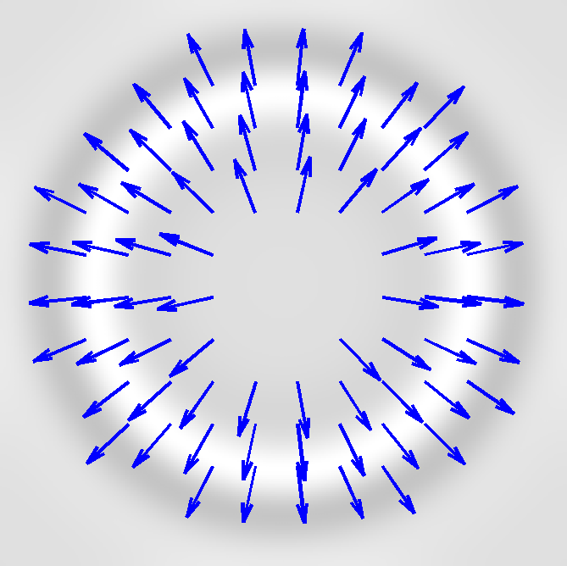
Riesz Transform
Riesz Transform
Input Subband
Riesz 1
Riesz 2
More Details in Paper!
Local Orientation
90 Degree phase shift
(Quadrature Mate)
Notes:
The key idea is that the Riesz Transform subbands, allows us to compute the local dominant orientation at every point *
And then compute a 90 degree phase shifted version of the input subband in the direction of that local dominant orientation, ……. rather than choosing a single orientation for every point in the subband.
More details about how this is done are available in the paper.

Slide 27
Phase Shifting Riesz Transform
Arbitrary phase shifting in local dominant direction
Local Phase shift $↔$Local Translation in Dominant Orientation
Input Subband
Quadrature Mate
Phase Shifting Subband
Quadrature Pair
Notes:
Now that we have a 90 degree phase shifted version of the input, we can combine them to form a quadrature pair, that we can phase-shift as before to approximate local translations in direction of the dominant orientation!

Slide 28
Motion Processing with Riesz Pyramid
Laplacian Pyramid
Input
Notes:
In summary, we briefly go through the whole processing pipeline.
We take a video and construct a Laplacian pyramid of it. We perform phase shifting on these different scales independently.
*We’ll continue describing the pipeline with only one subband.

Slide 29
Motion Processing with Riesz Pyramid
Riesz Transform
Spatio-temporal Filtering
Laplacian Pyramid
Quadrature Pair and Phase
Amplification and Phase-Shifting
Level of Riesz
Pyramid
Amplitude
and Phase
Filtered
Phase
Motion Magnified
Subband
Input
Notes:
For each subband, we compute the Riesz transform
We can use the Riesz components to compute the 90 degree phase shifted version of the subband and then compute the phase from the resulting quadrature pair
We can temporally filter the phase to isolate motions of interest and then denoise it spatially to improve SNR.
And then, we phase shift the original Riesz pyramid coefficient to form a motion magnified subband.

Slide 30
Talk Overview
Review of Phase-Based Video Magnification
Our SIGGRAPH 2013 Paper (Wadhwa et al. 2013)
Riesz Transform and Riesz Pyramid
This paper
Results and Live Demonstration
Notes:
Now, I’ll show you some new offline results and then demonstrate our online version of the algorithm.

Slide 31
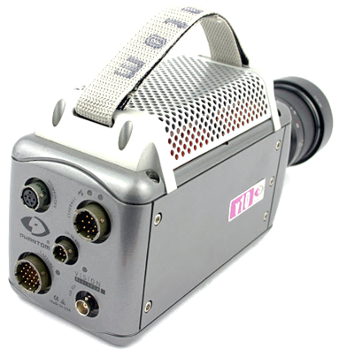
Concrete Compression
Compressor
Concrete block
Sequence courtesy of Stephen Morgan and Prof. Herbert Einstein, MIT CEE
Notes:
When people try to determine the strength of concrete*
, they place it in a device that compresses it.*
*We obtained a high speed video of damaged concrete being compressed.

Slide 32
Concrete Compression
Input (5000 FPS)
X15 (20-100 Hz)
Notes:
We take the original sequenece, shown on the left,
And motion magnify it, shown on the right, to make more evident the shearing that occurs as the concrete breaks.

Slide 33
Concrete Compression
X15 (20-100 Hz)
Notes:
If you missed it, here is only the processed video again.
And again.

Slide 34
Drum
Notes:
In another sequence, we struck a drumhead and recorded the result at 1900 FPS

Slide 35
Drum
Input (1900 FPS)
x10 (28-32Hz)
Notes:
We took this video, shown on the left, *
and were able to separate and amplify several different modes of the drumhead using the Riesz Pyramid.
On the right is the fundamental mode of the drumhead isolated. You can see the drumhead membrane moving up and down.

Slide 36
Drum
x10 (74-78Hz)
x10 (112-118Hz)
Notes:
Here are two more modes of the drumhead.
Circular membranes such as the drumhead have a large number of modal shapes occuring at nearby temporal frequencies.

Slide 37
More Drumhead Modes
X20 (140-146Hz)
X50 (185-195Hz)
X50 (221-231Hz)
Notes:
Here are three more modes, two of which we had to amplify 50 times to make visible.

Slide 38
Falling Metal Corner Brace
Input (10000FPS)
Third Time Derivative amplified 500 times
Notes:
In this sequence, we dropped a metal corner brace on the ground.*
In the processed video on the right, we amplified the third time derivative of the motions by 500 times. This eliminates motions due to gravity and amplifies everything else.
When the corner brace hits the ground, you can see the collision induced vibrations.

Slide 39
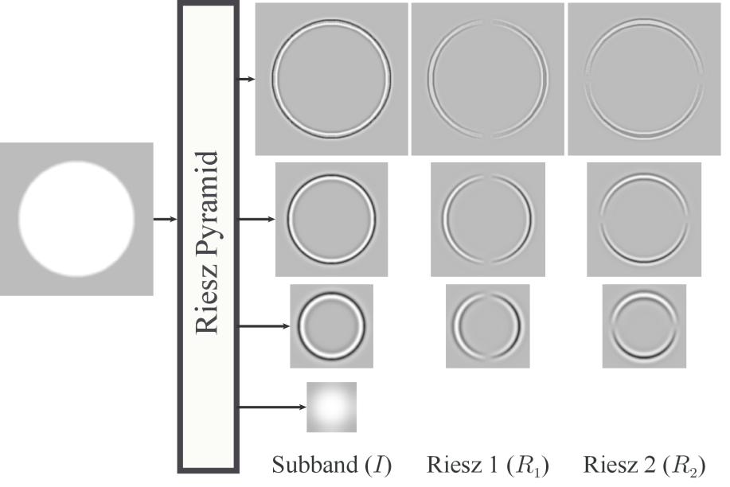
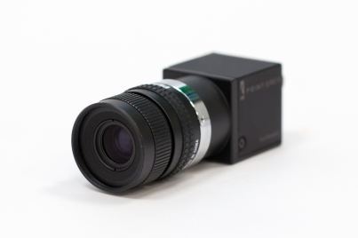
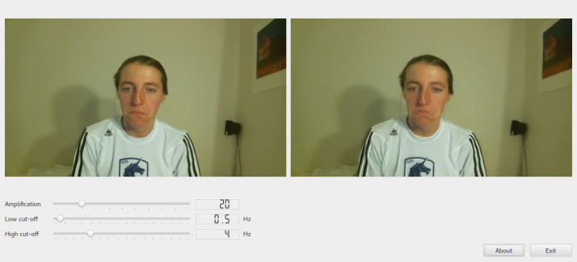
Contributions
New fast image representation
Laplacian Pyramid
Fast approximate Riesz transform
Riesz transform for phase-based motion processing
Real-time motion magnification
Notes:
Our contributions in this work have been
*A new fast image representation, the Riesz pyramid, that is composed of a Laplacian pyramid and a fast approximate riesz tranform
*Applying the Riesz transform for phase-based motion processing
*And a realtime implementation of motion magnification,

Slide 40
Live Demonstration
Notes:
Which we will now demonstrate.
There are a lot of vibrations in the world, in this very room, that we can’t see because they are too fast and too small.
We’ll solve the too fast problem by using the stroboscopic effect.

Slide 41
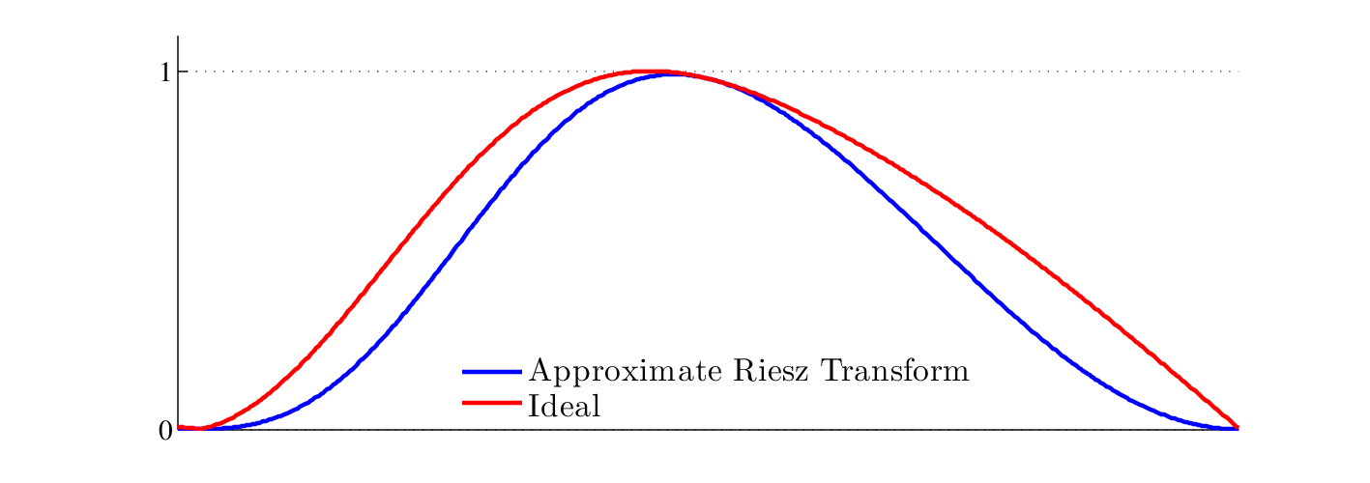
More details in paper
Fast Approximate Riesz Transform
Three tap finite difference filters
$[0.5 0 −0.5]$an ${\left[0.5 0 −0.5\right]}^{T}$
Sign ambiguity
Magnitude
$$0$$
$$π/2$$
$$π$$
Normalized Frequency
Notes:
There are a few more subtle points we haven’t discussed.
Rather than use the ideal Riesz transform specified in the Fourier domain, we use a fast approximate Riesz transform that has a similar amplitude and phase response
To the ideal Riesz transform
There is also sign ambiguity in the phase depending on whether the orientation is at angle theta or its antipode theta+pi.
We discuss how to resolve this in the paper and provide an alternate formulation using Quaternions that takes care of this problem.

Slide 42
Pros/Cons vs. Complex Steerable Pyramid
Input with many orientations everywhere
$$=$$
Motion (0.1px)
$$+$$
$$+$$
$$+$$
Notes:
The Riesz pyramid assumes that there is a single orientation at every point and *
may not perform well on complex textures such as this one, *composed of the sum of four oriented sinusoids

Slide 43
Pros/Cons vs. Complex Steerable Pyramid
Input
Motion (0.1px)
Ground Truth (x20)
8 Orientation CSP
2 Orientation CSP
Riesz Pyramid
Notes:
In fact, while the eight orientation complex steerable pyramid is able to almost perfectly amplify the motions,
*…the Riesz pyramid is not. The two orientation complex steerable pyramid also fails to amplify this sequence perfectly as it is incapable of separating the texture into its component sinusoids.

